Slide 1
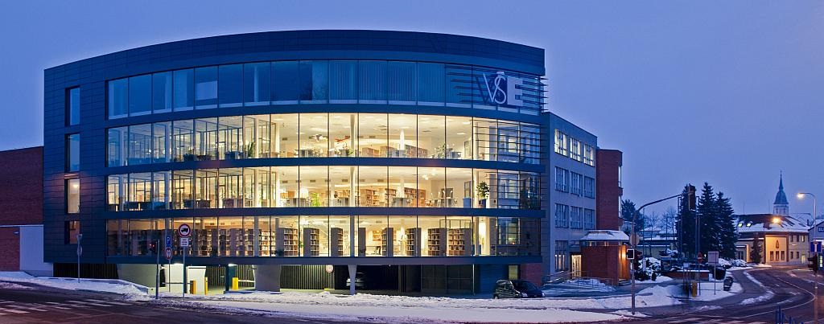
Faculty of management University of Economics
IN Jindřichův HradEC

Slide 2
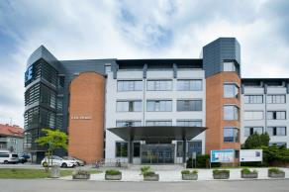
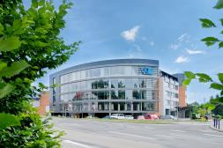
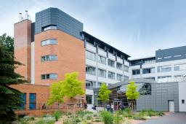
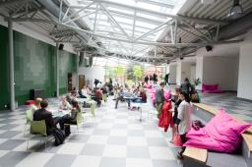
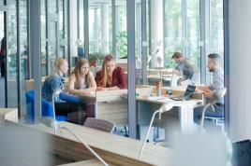

GENERAL INFORMATION
The Faculty offers bachelor's, master's and doctoral degree in management
  full time and combined forms
  modular form of study
The Faculty has a fully equipped and newly renovated facility
  main building, library and information centre, dorm complex and canteen
  modernization from EU funds – OP Research and Development for Innovation
The faculty offers its students
  environment of the largest and oldest Czech economics and management universities
  quality education at all three levels of university studies
  tailoring studies according to individual student needs
  extensive possibilities of studying abroad
  high rate of graduates working in the field
  new Library and Information Centre and renovated dorms
  study in homelike and friendly atmosphere in Jindřichův Hradec with a rich cultural and
  social life
1

Slide 3
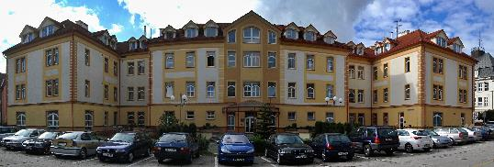
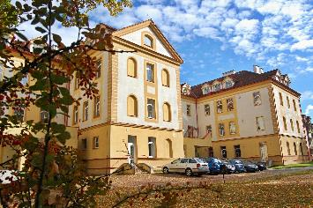
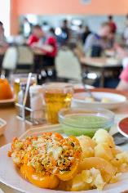
Dormitory AND CANTEEN
A 10-minute walk from the faculty building
  quiet part of the city centre
  all civic amenities in the vicinity
Sufficient capacity in dormitories : 343 beds
  cellular type of accommodation
Possibilities for sporting and social activities
Possibility to park directly in front of the dormitory
Canteen located in the dormitory
  two meals at a discounted price for students
First–year students given priority according to the criteria for allotting dormitory positions
2

Slide 4
CONDITIONS OF ACCEPTANCE
My life,
MY EDUCATION
Entrance examination consisting of the following parts
Prerequisites of Managerial Decision-Making
  World language
    English, German, Russian, French or Spanish
The entrance exam will be waived for applicants who duly submit the application form, in writing, requesting a waiver for the entrance exam and who fulfil one of these conditions
  demonstrate the required grade average in mathematics and one of the aforementioned languages, if you have studied each of these subjects at least three years on the Czech and Slovak secondary school
  the outcome of Test of General Academic Prerequisites within the National Comparative Exams at SCIO meet the required criteria
Application deadline for Bachelor Studies
  1. round of admission procedure – 1 December 2016 – 30 April 2017
  2. round of admission procedure – 1 July 2017 – 20 August 2017
For more information see: https://www.fm.vse.cz/zajemci-o-studium/bakalarsky-studijni-program/
3

Slide 5
Modular studies
Elective modules
credit system
system is based on credit evaluation of study obligations
European Credit Transfer and Accumulation System (ECTS)
Modules from specialized branches
Bachelor's degree
three-year study focused on a cross-sectional area from the field of management
role of middle and senior management levels for various types of organizations
Professional modules
Branch modules
Subsequent Master’s degree programme
deepen the knowledge gained in the Bachelor's degree studies
possibility of specialization
higher and top levels of managing organizations
extraordinary studies
study six subjects, first year bachelor degree study
successfully completed subjects will be recognized as completed in the next year for students accepted into full-time education
Required modules (core foundation)
4

Slide 6
international exchange
STUDY THE
WORLD
Faculty actively uses the VŠE partner network of more than 200 universities on four continents (52 countries)
  annually sends more than two dozen students abroad in the bachelor’s and master’s programmes
  academic staff also travel abroad for teaching or scientific research stays every year
The Faculty of Management provides exceptional support for these exchanges
  we work with the International Exchange Office at VŠE to provide current information and organising the selection process
  has an International Exchange Coordinator
  holds International Days
  contributes to students stay abroad with its own resources
5

Slide 7
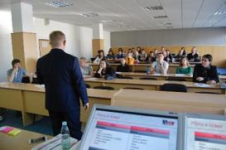
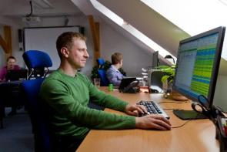
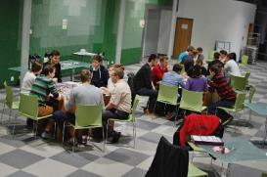
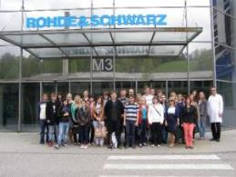
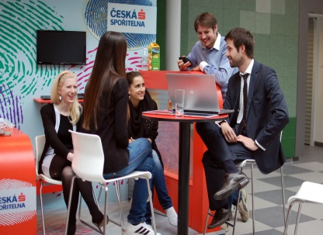
Practical training and excursions
GAIN EXPERIENCE,
DO IT
Faculty of Management has created a network of more than 30 partner organizations from different sectors
  i.e. Českomoravská stavební spořitelna, Československá obchodní banka, DM drogerie markt, Pelhřimov Hospital, Rohde & Schwarz
Actively cooperates with other organizations
  I.e. Bernard, Bosch Jihlava, Deloitte, E.ON, Lidl, Škoda auto, UniCredit Bank, Unilever
Students have the opportunity to participate short-term internships at partner companies within the credit-rated modules
Students have the opportunity to meet regularly with experienced representatives of organizations in teaching, professional seminars and through excursions
Faculty organizes an annual job fair and a new student meetings with partner organizations “Let’s get to work!”
6

Slide 8






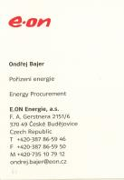
alumni employment
Faculty of Management graduates have long-term excellent labour market employment in various positions
Typically applied in
  production companies
  Financial institutions
  Project offices
  Consulting companies
  Pharmaceutical companies
  public organizations (municipal and regional authorities, ministries, customs and financial administration)
7

Slide 9
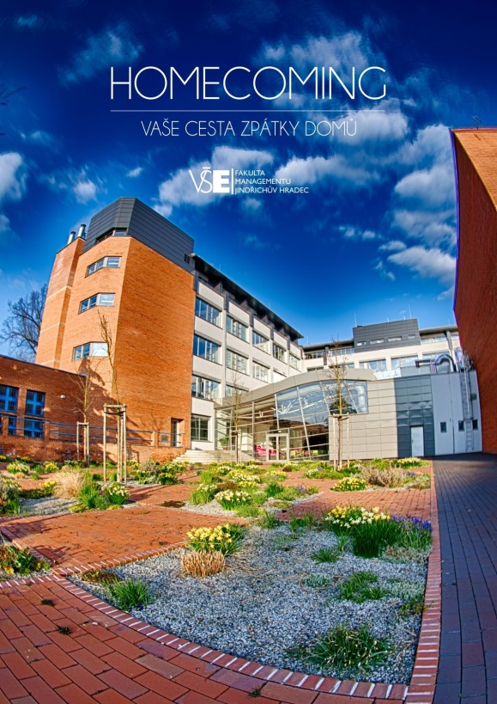
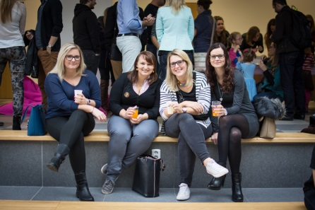
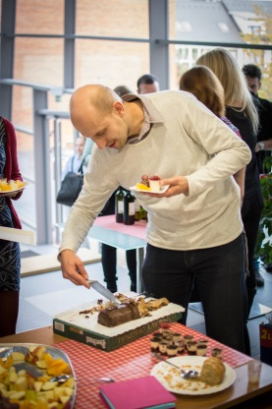
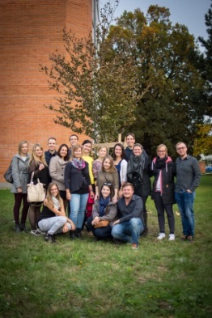
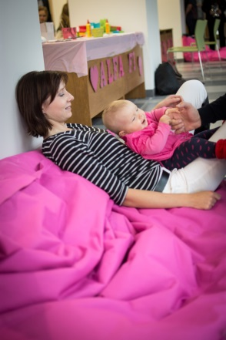
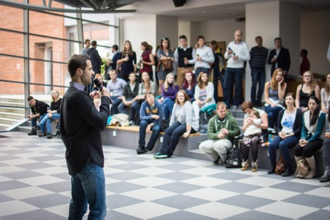
alumni relations
Faculty of Management continuously develops relationships with its alumni and endeavours to stay in close contact with them
  faculty mug for fresh graduates as a graduation keepsake
  informal meetings with alumni : Hradecký slučák, Homecoming – your way back home
  consulting by the faculty
  together we care about the graduation tree
  “a coffee with the vice-dean”
  involvement of graduates into teaching and scientific lectures
  using alumni as contact persons at partner organizations/professional organizations
8

Slide 10
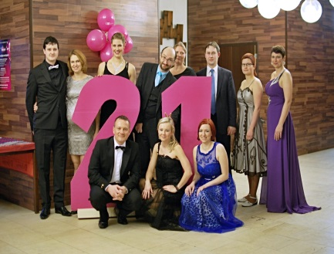
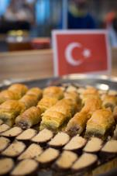
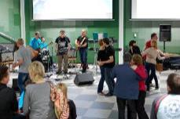
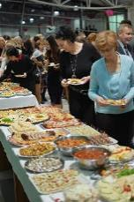
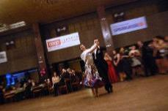
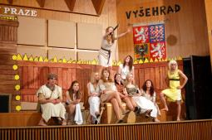
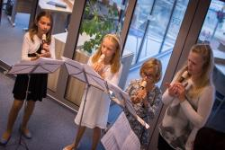
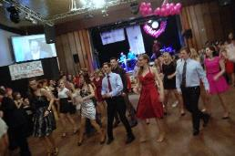
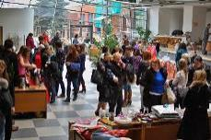
Social life
The Faculty of Management has a number of student organizations and clubs
  Theatre group FAMA
  the first Czech university sorority Alfa Fí
  student magazine PRIMETIME
  volunteer programme 5P
  student PR team
  student band
You can visit various social and cultural events every month
9

Slide 11
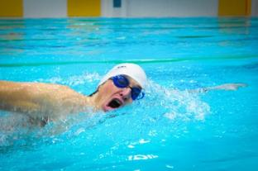
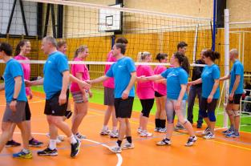
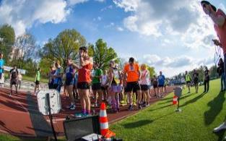
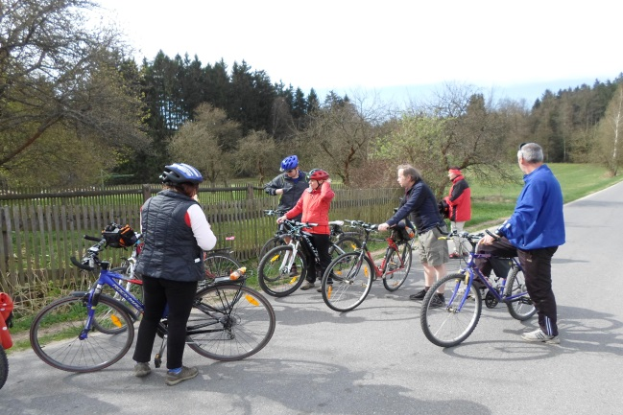
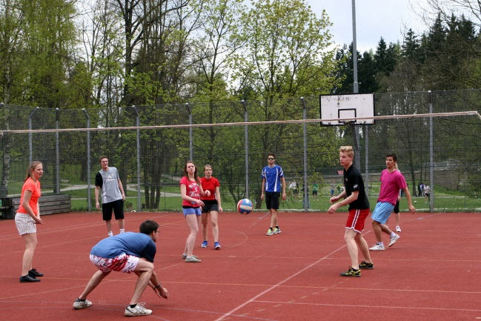
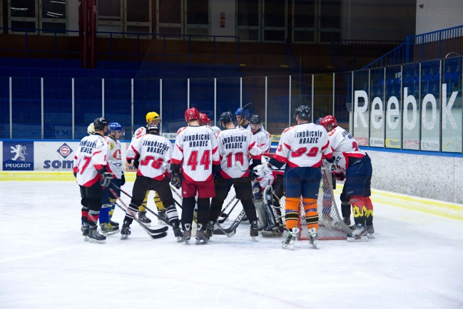
University sports club
University sports club organizes sports activities for students and faculty stafff
  offers nearly two dozen sports activities throughout the week during the semester
    i.e. aerobics, spinning, fit boxing, TRX, swimming, climbing, hockey, table tennis, basketball and many more
Organizes or co-organizes individual sporting events
  Christmas swimming relay, Hradec Jogging Hour, Skiing with the Faculty of Management, hockey and volleyball matches, Rector's Sports Day
The annual membership fee is only CZK 500 for students
10

Slide 12

What we are proud of
The faculty is constantly evolving and trying to improve in all spheres
Recently, we succeeded in
  gaining 3rd place in a student poll Faculty of the Year 2016 in the category of Economics - public universities
  completing reconstruction of the entire faculty adding a 5th floor
  setting up procedures for systematic support for research activities of academic staff
  winning the Rector’s Award VŠE for prestigious publication
  hiring a project manager involved in preparing applications for aid from OP VVV funds
  intensifying the process internationalizing the faculty environment
      increasing outgoing and ingoing mobility
      Launching the AACSB accreditation process
  heightening relations with faculty graduates
  taking part in significant new partner network of important superregional organisations
  organising over 50 interesting educational, cultural, social and sporting events for students and employees
We’ll continue these positive trends in the future
11

Slide 13
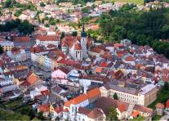
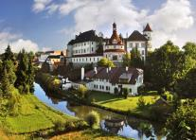
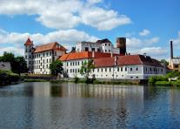
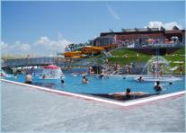
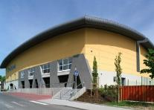
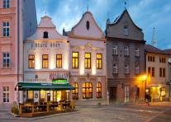
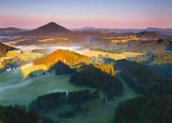
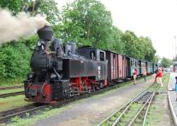
Jindřichův Hradec
Picturesque South Bohemian town with approximately 22,000 residents
Economic, administrative and cultural centre of the region
Good accessibility by car, bus or train
Quiet and very safe city
Well-preserved and popular historical centre
Healthy and beautiful scenery around the town (Czech Canada)
Sports and social facilities in the city
  sports stadium, sports hall, athletics stadium, swimming pool
  fitness centres, sports centres
  a dense network of bike and hiking trails
  cinema, theatre
  museums and galleries
  major cultural events throughout the year
Facilities for student life
  dozens of pubs and bars
  two discos
12

Slide 14






What to remember
We like graduates
We have a rich
social life
There is no shortage of practical experience
We’re VŠE, we’re in Jindřichův Hradec ☺
We study with high quality and modularly
We’re a family
We support travellers
13

Slide 15
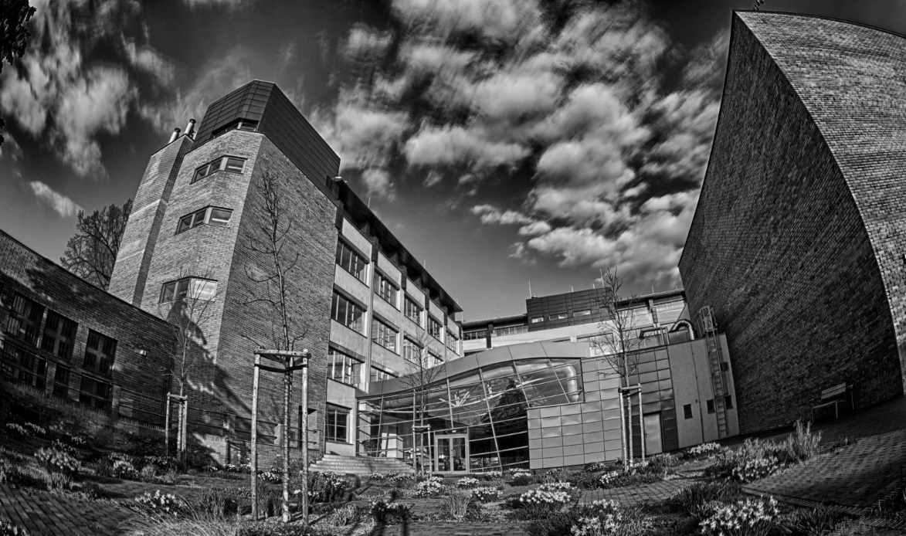


contact
Faculty of Management VŠE
Jarošovská 1117, Jindřichův Hradec
384 417 277
info@fm.vse.cz
http://www.fm.vse.cz
14

Slide 16
We look forward to seeing you in Hradec!

